Slide 1
Choosing Wisely®:
Things We Do for No Reason™
Routine Blood Culture Acquisition for Children Hospitalized with Community-Acquired Pneumonia
Based on Johnson DP, Lee V, Gourishankar A, Rajbhandari P, Schefft M, & Genies M. Routine blood culture acquisition for children hospitalized with community-acquired pneumonia . J Hosp Med. 2020 Feb 1;15(2):107-110.

Slide 2

Clinical Scenario
4 yo previously healthy, fully immunized boy presenting with 3 days of cough, fever, and decreased PO
Vital signs: T 102.7F, HR 115, RR 30, O₂ saturation 86% on room air
Physical exam: tachypneic, dry mucous membranes, decreased breath sounds in posterior right lung fields
CXR reveals opacification of right lower lobe concerning for community-acquired pneumonia
Admitted due to hypoxemia and dehydration, blood culture obtained and started on ampicillin
The next morning, he is clinically improved, but blood culture grows GPCs, so he is broadened to vancomycin
Speciation the following day confirms penicillin-sensitive Streptococcus pneumoniae.

Slide 3

Why You Might Think This is Necessary
The Infectious Diseases Society of America released recommendations for pediatric CAP in 2011¹
These recommendations encouraged blood cultures for children requiring hospitalization for moderate to severe CAP, but the definitions of moderate and severe were differently interpreted
There is broad hospital-to-hospital variation in rates of blood culture acquisition in this population²

Slide 4

Why This Is Unnecessary and Potentially Harmful
Viruses are the most frequently identified pathogen in the pediatric CAP³
In the conjugate vaccine era, true bacteremia occurs in 1.4-7% of children with CAP in whom blood cultures are obtained⁴⁻⁸
Bacteremia in uncomplicated CAP with a pathogen resistant to an aminopenicillin is very rare⁶
Isolating a contaminant in children with uncomplicated CAP has been shown to occur at the rate or exceeding the rate of true bacteremia in multiple studies^{4-7, 8, 9}
Empiric coverage with an aminopenicillin will provide adequate coverage while monitoring for improvement during hospitalization

Slide 5
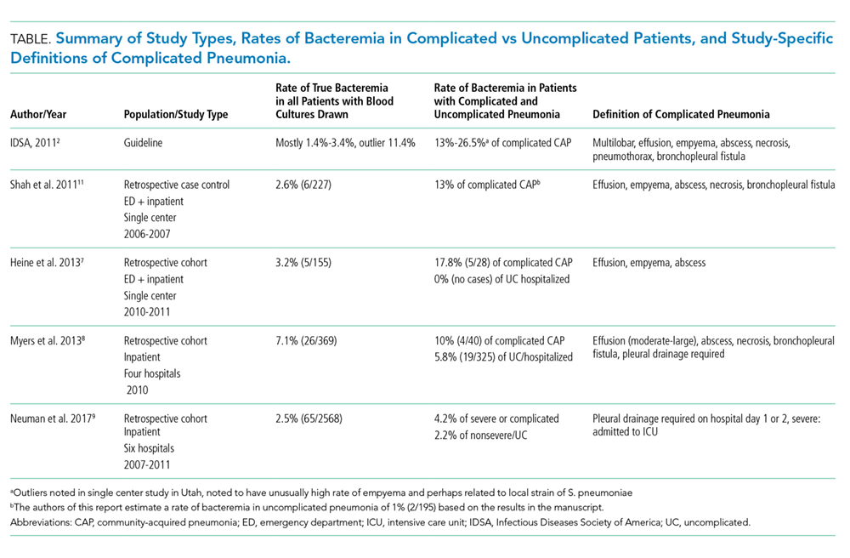
When a blood culture might be helpful
In complicated PNA
    More likely to have non-pneumococcal CAP and require antibiotics other than an aminopenicillin¹
    Incidence of bacteremia is significantly higher in complicated PNA (see below)
  In patients requiring ICU admission^{4,6}

Slide 6

What You Should Do Instead
Do not use hospital admission as the determining factor for blood culture acquisition
Reserve blood culture acquisition for children with complicated pneumonia, metastatic complications, or with ICU needs.
Empirically treat others with an aminopenicillin and consider blood culture acquisition if not improving on appropriate therapy, thus increasing the potential of yielding penicillin-resistant bacteria

Slide 7

Recommendations
Do not obtain blood culture routinely for children aged >3 months hospitalized for uncomplicated pneumonia.
Consider obtaining blood cultures in setting of:
    Complicated CAP with empyema, abscess, or fistula or metastatic complications of pneumonia
    ICU care required for shock of respiratory failure
    Concern for pathogens other than penicillin-sensitive S. pneumonia: immunocompromised, under-immunized status, or inadequate clinical response to empiric ampicillin therapy

Slide 8

Conclusions
Blood cultures rarely yield results that improve care for hospitalized children with uncomplicated CAP
Unnecessary blood cultures can lead to harm (increased length of stay, exposure to nephrotoxic agents, increased blood draws, etc)
Despite initial change to vancomycin when blood culture grew GPCs, the patient was switched back to high-dose amoxicillin when speciation returned
The isolation of S. pneumonia resulted in extra blood draws, exposure to vancomycin and an extra hospital day but did not benefit the child
Case Scenario

Slide 9

References
Based on Johnson DP, Lee V, Gourishankar A, Rajbhandari P, Schefft M, & Genies M. Routine blood culture acquisition for children hospitalized with community-acquired pneumonia. J Hosp Med. 2020 Feb 1;15(2):107-110.
1. Bradley JS, Byington CL, Shah SS, et al. The management of community-acquired pneumonia in infants and children older than 3 months of age: clinical practice guidelines by the Pediatric Infectious Diseases Society and the Infectious Diseases Society of America. Clin Infect Dis. 2011;53(7):e25-76.
2. Brogan TV, Hall M, Williams DJ, et al. Variability in processes of care and outcomes among children hospitalized with community-acquired pneumonia. Pediatr Infect Dis J. 2012;31(10):1036-1041.
3. Jain S, Williams DJ, Arnold SR, et al. Community-acquired pneumonia requiring hospitalization among U.S. children. N Engl J Med. 2015;372(9):835-845.
4. Heine D, Cochran C, Moore M, Titus MO, Andrews AL. The prevalence of bacteremia in pediatric patients with community-acquired pneumonia: guidelines to reduce the frequency of obtaining blood cultures. Hosp Pediatr. 2013;3(2):92-96.
5. Myers AL, Hall M, Williams DJ, et al. Prevalence of bacteremia in hospitalized pediatric patients with community-acquired pneumonia. Pediatr Infect Dis J. 2013;32(7):736-740.
6. Neuman MI, Hall M, Lipsett SC, et al. Utility of Blood Culture Among Children Hospitalized With Community-Acquired Pneumonia. Pediatrics. 2017;140(3).
7. Sandora TJ, Desai R, Miko BA, Harper MB. Assessing quality indicators for pediatric community-acquired pneumonia. Am J Med Qual. 2009;24(5):419-427.
8. Shah SS, Dugan MH, Bell LM, et al. Blood cultures in the emergency department evaluation of childhood pneumonia. Pediatr Infect Dis J. 2011;30(6):475-479.
9. Mendoza-Paredes A, Bastos J, Leber M, Erickson E, Waseem M. Utility of blood culture in uncomplicated pneumonia in children. Clin Med Insights Pediatr. 2013;7:1-5.

Slide 10
Citation
To cite this teaching tool:

